Slide 1
Lesson 5: Recurrent Neural Networks
Eric Keilty

Slide 2

Feed Forward Networks
Any network that can be organized into sequential layers
MLPs
CNNs
Some set of connections
Some set of connections
input
output
$L−1$ Layers

Slide 3
Recurrent Networks
Any network that is not a feed forward network (not really helpful)
A network organized such that there exists a backwards connection
In practice, useful networks have this backwards this connection from the output back to the input
Some set of connections
Some set of connections
input
output
Recurrent connections

Slide 4
The Recurrent Neural Network: Architecture
output
hidden
RNN
Cell
input

Slide 5
Reduction to Feed Forward Networks
Recall that all CNN’s an be converted to MLPs
Is there a similar property for RNNs? Can all RNNs be converted to feed forward networks?

Slide 6



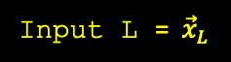
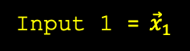

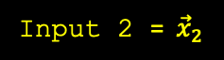
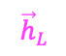



Unrolling the RNN
Output 1 = ${\vec{h}}_{1}$
Output 2 = ${\vec{h}}_{2}$
Output L = ${\vec{h}}_{L}$
RNN
Cell
$${\vec{h}}_{1}$$
RNN
Cell
$${\vec{h}}_{2}$$
$${\vec{h}}_{L−1}$$
RNN
Cell
$${\vec{h}}_{0}$$
$${\vec{h}}_{L}$$
Input 1 = ${\vec{x}}_{1}$
Input 2 = ${\vec{x}}_{2}$
Input L = ${\vec{x}}_{L}$
Initialized randomly or with all 0’s
What is often considered the output

Slide 7
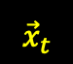
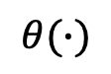
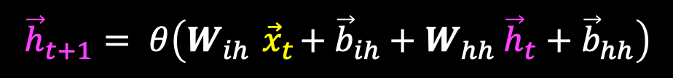
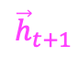

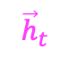
The Recurrent Neural Network: Math
$${\vec{h}}_{t+1}$$
$$θ(∙)$$
$${\vec{h}}_{t}$$
Linear
$$∑$$
$${\vec{h}}_{t+1}= θ\left(W_{ih}{ \vec{x}}_{t}+{\vec{b}}_{ih}+W_{hh} {\vec{h}}_{t}+{\vec{b}}_{hh}\right)$$
Linear
Usually tanh
$${\vec{x}}_{t}$$

Slide 8
Advantages of RNNS
Allow our models to have memory
Therefore, it is applicable to any sequential data processing and will be more compact than other architectures
Language Modeling / Text Generation
Machine Translation
Speech Recognition
Video Tagging
Variable input size (this is not possible in previous models without some clever tricks)

Slide 9
Problems with RNNs
Exploding / Vanishing Gradients
Performance decreases as sequences get larger due to long-term dependencies, since each RNN cell only has access to the previous hidden state
Due to the sequential nature of RNNs, backprop is not computationally efficient nor parallelizable, so they are slow on GPUs

Slide 10
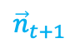
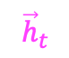
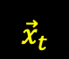

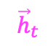



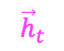

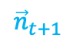
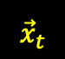


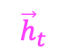
The Gated Recurrent Unit (GRU)
$${\vec{h}}_{t+1}$$
$${\vec{r}}_{t+1}$$
$${\vec{n}}_{t+1}$$
$${\vec{z}}_{t+1}$$
$${\vec{h}}_{t}$$
$${\vec{h}}_{t}$$
$${\vec{r}}_{t+1}$$
$${\vec{h}}_{t}$$
$${\vec{z}}_{t+1}$$
RNN
Cell
Reset Gate
RNN
Cell
Update Gate
$${\vec{x}}_{t}$$
$${\vec{h}}_{t}$$
$${\vec{x}}_{t}$$
$${\vec{x}}_{t}$$
$${\vec{h}}_{t}$$
$${\vec{n}}_{t+1}$$
$${\vec{x}}_{t}$$

Slide 11



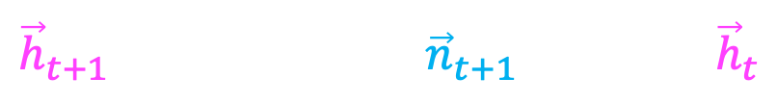
The Gated Recurrent Unit (GRU)
$${\vec{r}}_{t+1}= σ\left(W_{ir}{ \vec{x}}_{t}+{\vec{b}}_{ir}+W_{hr} {\vec{h}}_{t}+{\vec{b}}_{hr}\right)$$
$${\vec{z}}_{t+1}= σ\left(W_{iz}{ \vec{x}}_{t}+{\vec{b}}_{iz}+W_{hz} {\vec{h}}_{t}+{\vec{b}}_{hz}\right)$$
$${\vec{n}}_{t+1}=tanh\left(W_{in}{ \vec{x}}_{t}+{\vec{b}}_{in}+{\vec{r}}_{t+1}∘(W_{hn} {\vec{h}}_{t}+{\vec{b}}_{hn})\right)$$
$${\vec{h}}_{t+1}=\left(1−{\vec{z}}_{t+1}\right)∘{\vec{n}}_{t+1}+{\vec{z}}_{t+1}∘ {\vec{h}}_{t}$$
$$\vec{x}∘\vec{y}$$
denotes element-wise multiplication

Slide 12



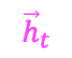


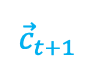





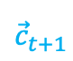
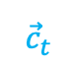

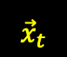
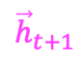

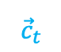
Long Short Term Memory Network (LSTM)
$${\vec{c}}_{t+1}$$
$${\vec{h}}_{t+1}$$
$${\vec{g}}_{t+1}$$
$${\vec{i}}_{t+1}$$
$${\vec{f}}_{t+1}$$
$${\vec{o}}_{t+1}$$
$${\vec{c}}_{t}$$
$${\vec{h}}_{t}$$
$${\vec{h}}_{t}$$
RNN
Cells
(Gates)
$${\vec{c}}_{t}$$
Cell State Update
$${\vec{c}}_{t+1}$$
Hidden State Update
RNN
Cell
$${\vec{h}}_{t}$$
$${\vec{x}}_{t}$$
$${\vec{x}}_{t}$$
$${\vec{g}}_{t+1}$$
$${\vec{i}}_{t+1}$$
$${\vec{f}}_{t+1}$$
$${\vec{o}}_{t}$$
$${\vec{x}}_{t}$$

Slide 13





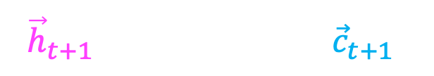
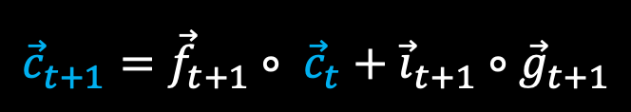
Long Short Term Memory Network (LSTM)
$${\vec{i}}_{t+1}= σ\left(W_{ii}{ \vec{x}}_{t}+{\vec{b}}_{ii}+W_{hi} {\vec{h}}_{t}+{\vec{b}}_{hi}\right)$$
Input Gate
$${\vec{f}}_{t+1}= σ\left(W_{if}{ \vec{x}}_{t}+{\vec{b}}_{if}+W_{hf} {\vec{h}}_{t}+{\vec{b}}_{hf}\right)$$
Forget Gate
$${\vec{g}}_{t+1}=tanh\left(W_{ig}{ \vec{x}}_{t}+{\vec{b}}_{ig}+W_{hg} {\vec{h}}_{t}+{\vec{b}}_{hg}\right)$$
Candidate Next Cell State
$${\vec{o}}_{t+1}= σ\left(W_{io}{ \vec{x}}_{t}+{\vec{b}}_{io}+W_{ho} {\vec{h}}_{t}+{\vec{b}}_{ho}\right)$$
Output Gate
$${\vec{c}}_{t+1}={\vec{f}}_{t+1}∘ {\vec{c}}_{t}+{\vec{i}}_{t+1}∘{\vec{g}}_{t+1}$$
$${\vec{h}}_{t+1}={\vec{o}}_{t+1}∘ tanh⁡({\vec{c}}_{t+1})$$
$$\vec{x}∘\vec{y}$$
denotes element-wise multiplication

Slide 14
GRU and LSTM Intuition
Both are attempting to learn what is important and what to forget
In the GRU this is done using the Reset and Update Gate
In the LSTM this is done using the cell state
See this famous blog post for more detail about these architectures
https://colah.github.io/posts/2015-08-Understanding-LSTMs/
The LSTM is by far the more popular model to use due to the distinction between the hidden state and the cell state

Slide 15
Assignment 5a
We will be creating a very simple RNN that can add arbitrarily long sequences of integers
This should help you get an intuition as to how the RNN’s hidden state can be used as memory to store previous inputs
It will also show you why a simple vanilla RNN are not very power and why GRUs and LSTMs are necessary

Slide 16


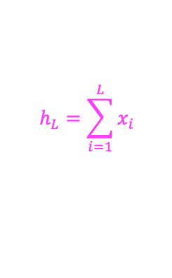


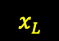

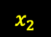
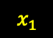

Assignment 5a: Part 1
First, as usual, you will create a hand-crafted solution to this toy problem
You need to find $W_{ih} , b_{ih},W_{hh} ,$and $b_{hh}$
RNN
Cell
$$h_{1}$$
RNN
Cell
$$h_{2}$$
$$h_{L−1}$$
RNN
Cell
$$h_{L}=\sum_{i=1}^{L}{x_{i}}$$
$$h_{0}=0$$
$$x_{1}$$
$$x_{2}$$
$$x_{L}$$
$$h_{t+1}=W_{ih}{ x}_{t}+b_{ih}+W_{hh} h_{t}+b_{hh}$$

Slide 17

Assignment 5a: Part 2
You will implement a simple RNN using PyTorch
You will be using nn.RNNCell. I encourage you to open the documentation while doing this part of the assignment
Note: the architecture being used to train is PyTorch is not the same as the one you created in the hand-crafted solution. In the PyTorch architecture, ${ \vec{x}}_{t}$ was converted to a one-hot encoded representation. Why was this necessary for training using gradient descent?

Slide 18
Assignment 5b
We are using the famous MNIST dataset again! This will be very similar to Assignment 4b, except now we are using an RNN to classify handwritten digits
In this assignment you are using nn.RNN instead of nn.RNNCell. Again, I encourage you to open the documentation while doing the assignment
The difference is nn.RNNCell is just one RNN cell, while nn.RNN is the entire unrolled RNN
Therefore, nn.RNN takes in the entire sequence and outputs all hidden states, including the last hidden state

Slide 19
Assignment 5b: Architecture
row 1
row 2
28
28 input vectors of size 28
row 28
28

Slide 20


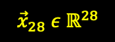


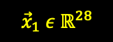





Assignment 5b: Architecture
$$z_{1}$$
$${\hat{y}}_{1}$$
RNN
Cell
$${\vec{h}}_{1}$$
$${\vec{h}}_{27}$$
RNN
Cell
$${\vec{h}}_{0}$$
${\vec{h}}_{28}$ =
Fully Connected
Softmax$(∙)$
$$z_{10}$$
$${\hat{y}}_{10}$$
$${\vec{x}}_{1} ε{ ℝ}^{28}$$
$${\vec{x}}_{28} ε{ ℝ}^{28}$$
hidden_size

